Slide 1
The wilderness weather system
Case study

Slide 2
Weather information
A national weather service wishes to collect weather information from remote areas to help with weather forecasting, forecast accuracy assessment and climate change modeling.
Currently, limited collections are made manually by people visiting remote stations every day.
This is expensive and time consuming
Some areas have no coverage because of difficulties of access (no road, heavy snowfall, etc.)
The intention therefore is to develop remote automatic collection systems that are connected to a broader weather information system.

Slide 3
Overall system organization
WS1
WS2
WS3
WS..
WSn
Weather information system
Satellite information
Weather radar information
Weather data archive

Slide 4
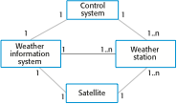
System context for the weather station

Slide 5
Weather station characteristics
Must be self-contained and completely autonomous
Integral power supplies and power generation
Satellite communications
Ruggedized to tolerate extreme weather
Self-testing
May exist in several version for different types of deployment
Highland areas based on wind power
Desert areas based on solar power
Remote control to support autonomous operation
Dynamic software re-configuration

Slide 6
Installed instruments
Anemometer – wind speed measurement
Barometer – air pressure measurement
Ground and air thermometers
Rain/precipitation gauge
Sunshine gauge
Visibility gauge

Slide 7
Essential system functionality
Collect weather information from instruments at regular intervals
Transmit this information, on request, to the weather information system over the satellite link
Store information if communications are not available
Monitor external conditions and shut down power generation/instruments if threat of damage from extreme weather
Run regular diagnostic tests to assess overall health of system

Slide 8
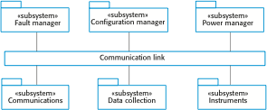
Software architecture

Slide 9
System software
Embedded software but not real-time in the sense that rapid reaction to events is required.
Developed using an object-oriented approach
OO approach associates objects with the physical entities in the system e.g.
Weather data collection instruments
Power supply and generation
Communications
Data may be stored as objects
No requirement for large-scale database

